Slide 1
The Uniquely Abled Project
North Central Ohio Region Industry Manufacturers Workforce Alliance
April 28, 2022
John Wheeler
Project Team Consultant
The Uniquely Abled Project™

Slide 2
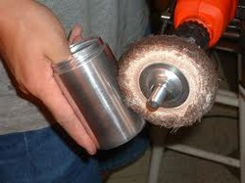
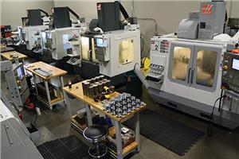
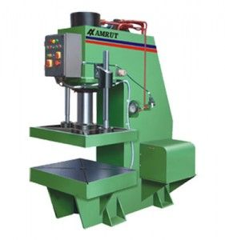
There is a high unfulfilled demand for skilled workers, e.g., CNC machine operators, inspectors, and for highly repetitive tasks.

Slide 3
#1 Problem for Business: Access to a skilled workforce
Notes:
This was true before the pandemic hit. It is likely to be true as we emerge to a “new normal”.
Skilled labor, i.e., someone who is a perfect fit for a particular job, is likely to be even more in demand as companies focus on efficiency and being competitive.

Slide 4
17% of the US Population is classified as disabled.
40 million
Notes:
17% of US population classified as “disabled”. That is 40 million people.

Slide 5
82% of those with a disability are not employed vs. 35% for those without a disability.
Notes:
And the unemployment rate ranges from 60-90%.
And these stats have not changed in decades.
We need a sustainable and scalable solution that will impact 40 million.
A problem of that size will not be solved with charity or government grants.
=====================================
In 2016, 17.9 percent of persons with a disability were employed, the U.S. Bureau of Labor Statistics reported. In contrast, the employment-population ratio for those without a disability was 65.3 percent.
Unemployment rate is 42% in the U.S. for people with autism. (Still 10 times higher than current rates)

Slide 6
These two problems are potential solutions for each other.
Business Problem
Unemployment
Problem

Slide 7
What is in the way of these being implemented as solutions for each other?
Business Problem
Unemployment
Problem
Notes:
The first obstacle is that the words we use when talking to a potential employer are often more about charity than business.

Slide 8
What comes to mind when we say someone is disabled?

Slide 9
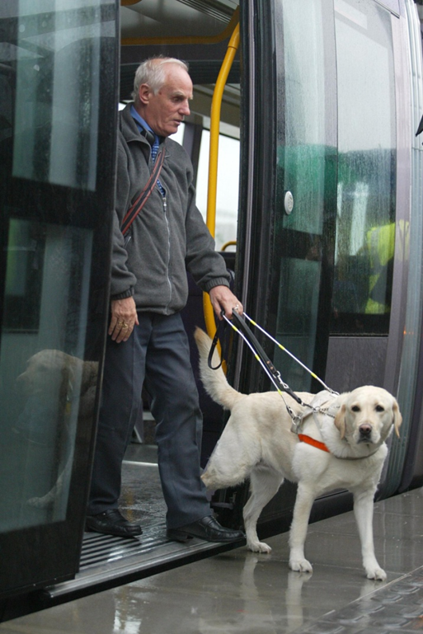
Disabled =>
What are they missing?
What can’t they do?
What compromises am I going to have to make to employ them?
What is the cost?
Is the benefit worth the cost?

Slide 10
What comes to mind when we say someone is uniquely abled?

Slide 11
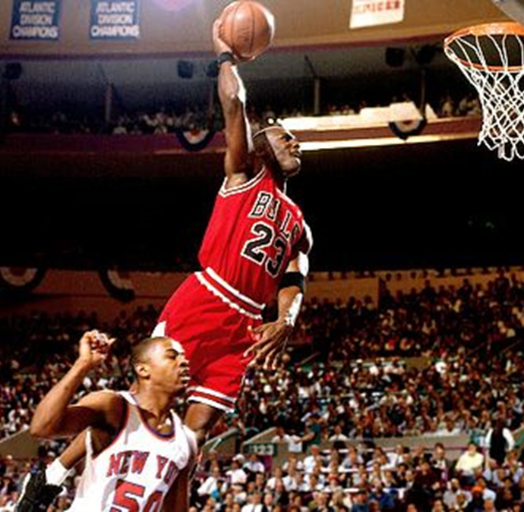
Uniquely Abled =>
What are they really good at?
How might their unique abilities help me?
What new things might be accomplished utilizing their unique abilities?
Notes:
These are words that are lenses through which we see the world. Another way of saying this is that the words we use literally create the world in which we operate.
These are also called “paradigms”
Rather than words that point what an individual can’t do, we use the term “uniquely abled individuals” to focus on what they can do uniquely well for a potential employer.

Slide 12
When one ability is diminished, the body makes up for it by causing other abilities to be extraordinary (unique abilities).
Notes:
Blind – can’t see, all our focus on the skill they don’t have
The extraordinary skills they do have: touch and hearing

Slide 13
Then ask, what job could use these unique abilities?
Notes:
What jobs could use those extraordinary skills? – being a masseuse

Slide 14
The purposes of the Uniquely Abled Project are to:
Shift the societal paradigm from “disabled” to “uniquely abled”.
Provide skilled workers by matching an individual’s unique abilities to the needs of career jobs in demand.
I can do it better than anyone.
You can’t.
Notes:
We are focused on jobs in B2B companies (uniquely abled individuals frequently placed in retail)
When integrate uniquely abled into regular workforce, the productivity and morale of the entire plant goes up.

Slide 15
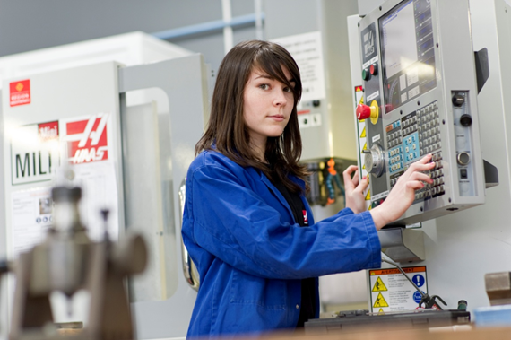
There are two programs of The UAP
The Uniquely Abled Academies™: For jobs that require prior training
The UAP Jobs Program™: For jobs that do not require prior training

Slide 16
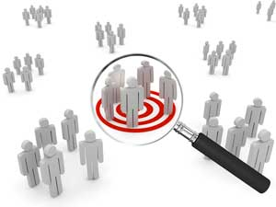
There are 9 critical components of career education facilities for the uniquely abled.
Selection of students
Notes:
Critical components needed for a successful program.
This also gives you a sense of what the 16-week program includes.
First is matching the students’ unique abilities to the selected job on which there will be training and job placement.

Slide 17
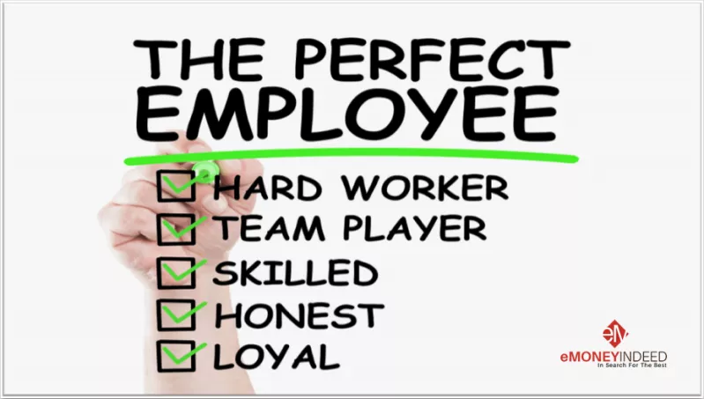
Typical abilities of a level 1 autistic are a perfect match for a CNC machinist.
Repetitive tolerant and detail focused.
Able to focus for long time periods.
Often high intelligence.
Often mechanically inclined.
Focused on accuracy, able to detect when something isn’t right.
Likes working alone.
Follows rules.
Does what they say they will do.
Dislikes transitions to a different company.
Very appreciative of having a job.

Slide 18
There are 9 critical components of career education facilities for the uniquely abled.
Financial support
Notes:
UAA is free.

Slide 19
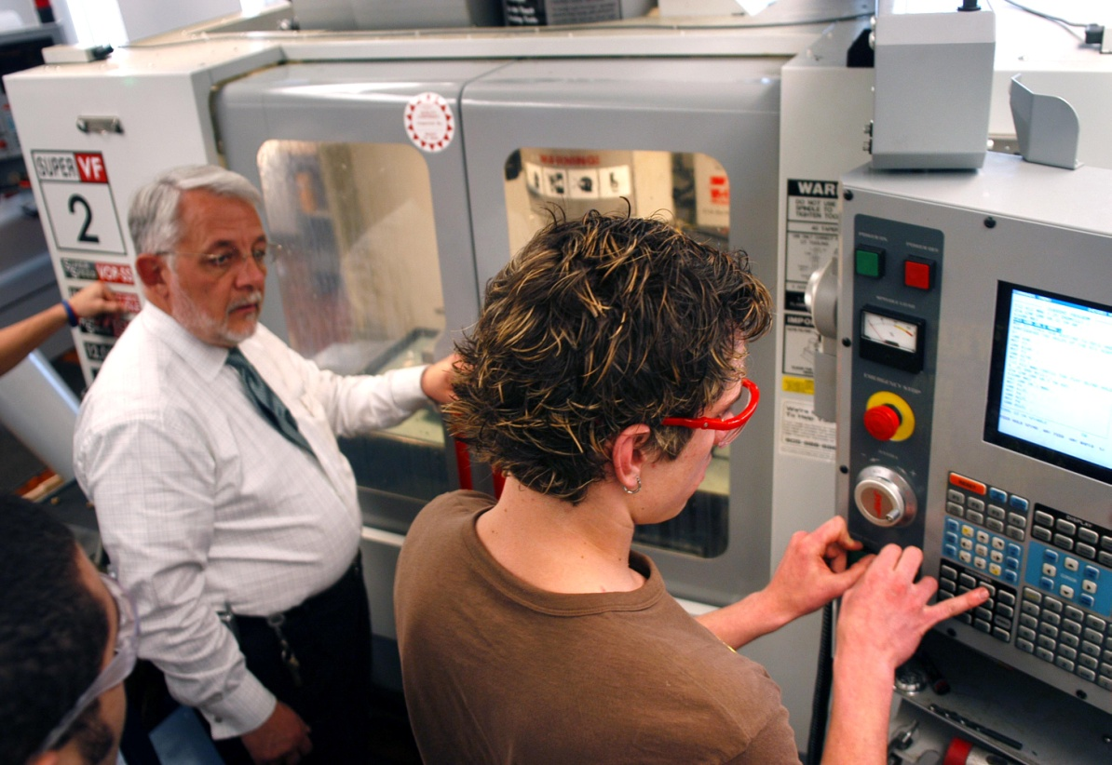
There are 9 critical components of career education facilities for the uniquely abled.
Technical skills training
Notes:
The skills of running a CNC machine

Slide 20
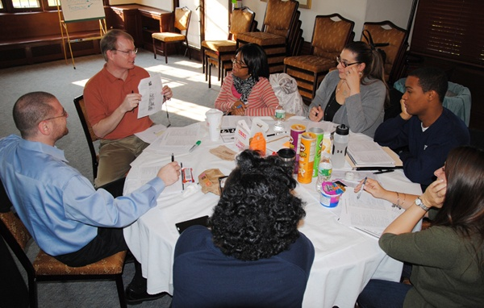
There are 9 critical components of career education facilities for the uniquely abled.
Train instructors on how to teach this uniquely abled population
Notes:
We will have a video ready later this year for UAA instructors.

Slide 21
There are 9 critical components of career education facilities for the uniquely abled.
Job readiness training (“soft skills”)
Notes:
Will have a curriculum and video for soft skills instructors later this year.

Slide 22
There are 9 critical components of career education facilities for the uniquely abled.
Support for job search and placement
Notes:
Here is where the Job Developer Workshop can really help job developers.

Slide 23
There are 9 critical components of career education facilities for the uniquely abled.
Coach potential employers how to select
Notes:
Typically uniquely abled individuals fail typical selection process, e.g., HR interviews. HR folks misjudge the behavior, e.g., not looking in their eyes as indicator of lying. Multiple people at one time are likely to shut them down.
This is NOT the way to select a candidate.

Slide 24
There are 9 critical components of career education facilities for the uniquely abled.
Coach employers how to on-board and manage
Notes:
Later this year will have a video for managers of UAA graduates.

Slide 25
There are 9 critical components of career education facilities for the uniquely abled.
Post-hire support (job coach, internship, etc.)

Slide 26
Each of the nine components is available from at least one organization, but collaboration is missing.
Notes:
Each of these functions offered by at least one organization, but they don’t collaborate.

Slide 27
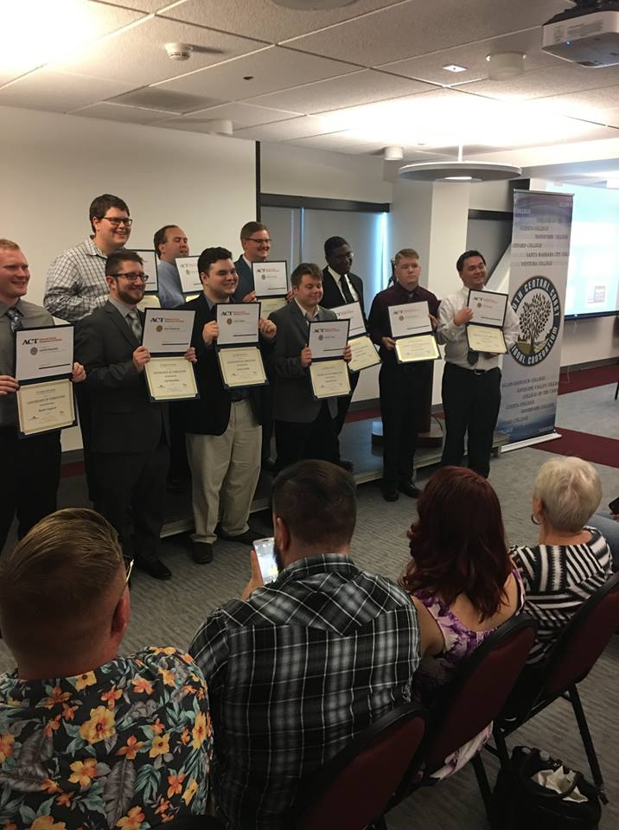
Uniquely Abled Academies
Trains those with level 1 (high functioning) autism to be CNC machine operators
16-week program, followed by job placement and post-hire support.
Managed locally.
Free to trainees.
Free to employers.
Is an almost 100% successful placement rate among the 90 graduates to date
Employers are delighted.
Notes:
So the first diagnosis-job match we picked for Uniquely Abled Academies has been level 1 autism and being a CNC machinist.
Our first UAA cohort graduated in August 2016 with a resulting almost 100% placement rate. To date have been 80 graduates, 10 are currently in training, and at least 15 UAAs will have been opened by Summer 2022.
Everyone, including the Host School, receives their normal fee. Most funding comes from state agencies (or federal funding related to helping people with employment challenges to get a career job). There are few appropriate training facilities, so the funding agencies typically love UAAs. We help the agencies be successful..
The UAP provides consulting services to those who want to get a UAA started and to the partnership of organizations committed to establishing a UAA, including a dedicated UAA Consultant. Also there is extensive documentation provided.

Slide 28
16 Planned or Opened UAAs by Summer 2022
Valencia, CA
Glendale, CA
Long Beach, CA
San Bernardino, CA
Torrance, CA
Hathorne, MA
Lima, OH
Cleveland, OH
Erie, PA
Meadville, PA
Middletown, CT
Troy, NY
Milwaukee, WI
North Mankato, MN
Cherry Creek Innovation Center, CO
Phoenix, AZ
Notes:
New Uniquely Abled Academies are being established across the US
The UAP provides consulting services.
Anyone can be the “seed” that helps establish a UAA.
Here are the sites having opened or are planned to open by Summer 2022.
More information, including status and contact information, is available on the UAP website under the “Hire for a Job” tab.
If you would like to get involved with Cherry Creek …….
If you would like to help to get a UAA established elsewhere…..
There are many conversations taking place with locations not listed.
If your city is not listed here and you’d like a UAA in your area, contact me.

Slide 29
UAA Cohort at Rhodes State College in Lima, Ohio
First cohort began 4/12/2021 and completed 7/31/2021.
Five students
Advertised on traditional as well as social media.
Cohort ran 5 days a week 8:00 AM until 4:00 PM. (Tried to emulate a typical work day.)

Slide 30
UAA Cohort at Rhodes State College in Lima, Ohio
As a result of advertising, our UAA was posted on the Facebook page of the Ohio Department of Higher Education. As a result of this posting, Lt. Governor Husted visited the cohort.
Curriculum consisted of:
Manual Machining
CNC Machining
Life Skills

Slide 31
UAA Cohort at Rhodes State College in Lima, Ohio
All five students completed the course.
All earned their OSHA 10 hour certification
Sat for NIMS Safety and Measurement Certification
One student decided early on that a machining career was not for him, but he did complete the course.
Of the other 4, three currently have jobs and the 4th is still looking. (Has transportation issues.)

Slide 32
Employers are Delighted
“After 2 ½ months he is equal to or better than the best CNC operator I have ever had.”
“They learn in weeks what takes others months.”
“They grasp things much faster than the average employee.”
“He’s eager to take on more knowledge and try anything we throw at him.”
“They are like ideal employees.”
Lusk Quality Machine Products

Slide 33
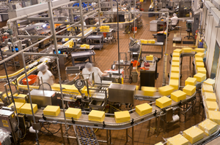
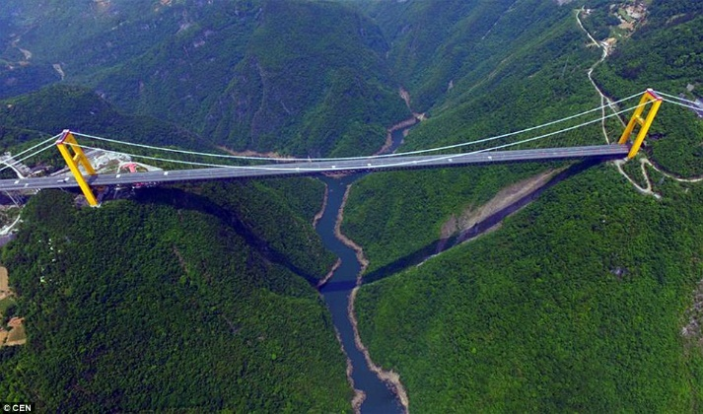
A gap exists…
Companies may not know about the agencies that are potential sources of workers.
Job developers may not know how to access the companies with career jobs.
Notes:
Progressive: clicks show companies, then job developers, then valley.
So there is a Valley between these two populations.
Click to show bridge: How is The Uniquely Abled Project helping bridge this gap?

Slide 34
Solution: Inform companies of the availability of uniquely abled populations that match their job openings.
Presentations to industry associations.
Articles in industry publications.
Notes:
Presentations – like here
Articles have been published in ToolingU-SME publication.

Slide 35
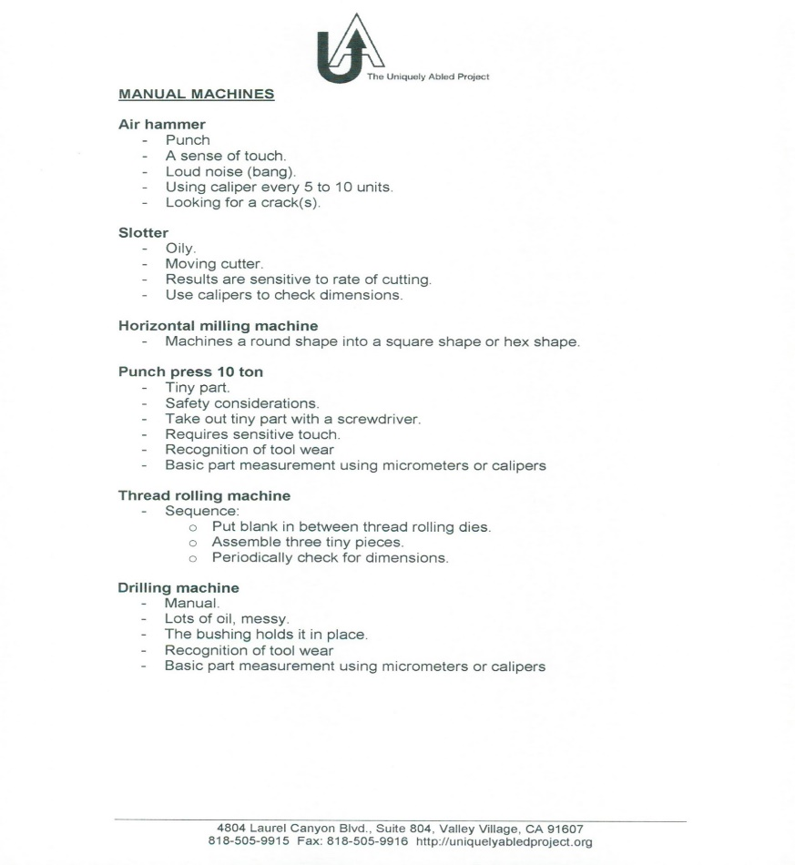
Solution: Have a common language between job developers and companies based on abilities required by a job.
Jobs Lists: lists of typical jobs in general manufacturing with the names, characteristics, skills, and unique abilities required for each job (available on UAP website).
Notes:
What is needed: descriptions of jobs and terms used to describe vacancies that both the company and job developers understand – a common language.
We encourage you to include unique abilities in your selection process and help job developers learn about your business, e.g., with brochures and visits to your sites.
A common language between companies and job developers is needed, so when you call and say, “I need a 10-ton press operator.” the job developer knows what you are talking about. We developed Job Lists that list the typical jobs in an industry (we started with manufacturing), together with the abilities and skills needed for that job.
Distinguish and list separately skills (typical contents of job descriptions, e.g., ability to use a micrometer) and abilities (able to tolerate high repetition and simultaneously maintain detail focus, able to reliably and quickly see when a part does not meet spec).
The first Job List is available for free on the UAP website.

Slide 36
Possible Actions
Use “uniquely abled” instead of “disabled”.
Use “abilities” in your job descriptions.
Consider hiring the uniquely abled as a business decision.
Connect UAP to potential Hosts (typically community colleges) of a Uniquely Abled Academy.
Invite UAP to speak to industry groups.

Slide 37
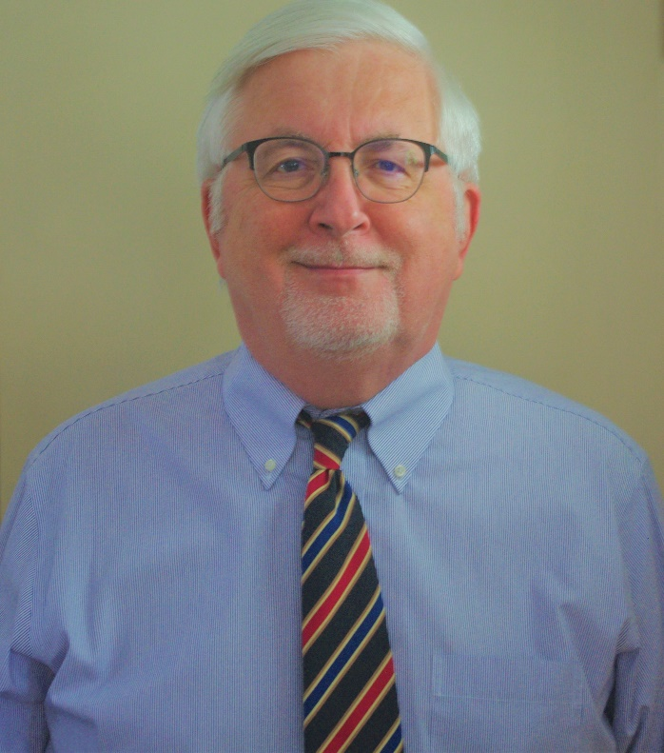
Questions?
John Wheeler
Project Team Consultant
The Uniquely Abled Project
UniquelyAbledProject.org
419-422-9467
trainmanjohn1955@gmail.com

